Slide 1
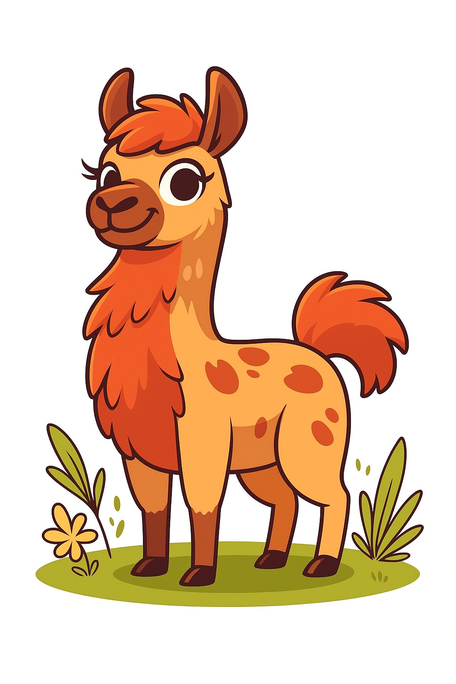
Output
...and pretraining
0
Hardware
1
1
Tokenization
2
2
Embeddings
3
4
3
Attention
0
4
Output

Slide 2
Overview
Neural networks
Softmax
Sampling methods
Training data
Scaling laws

Slide 3
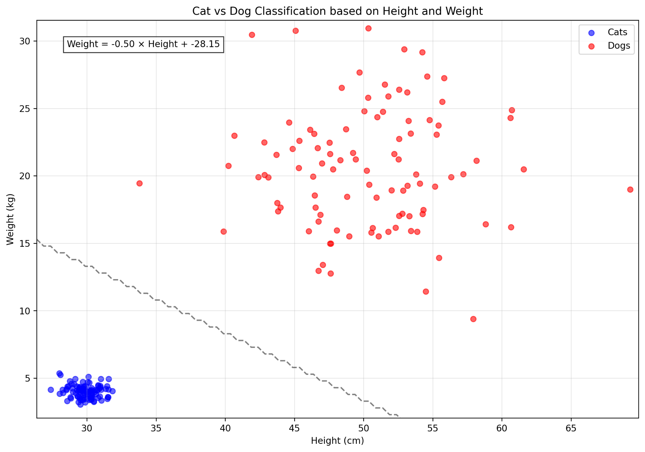

Slide 4
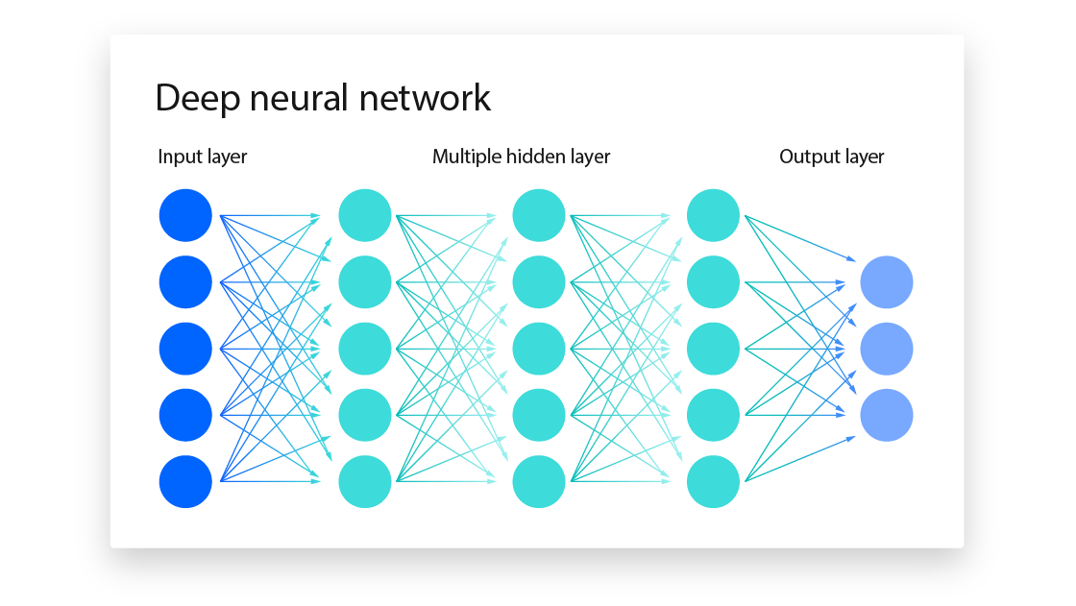
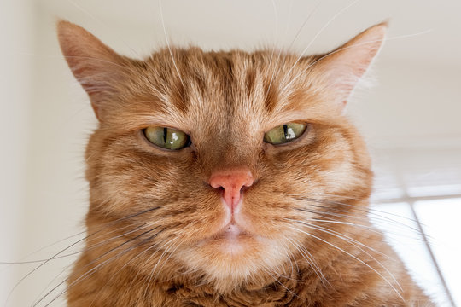
Neural networks
dog | 0.00
cat | 1.00
goose | 0.00
Unravel
0.92
0.81
0.95
0.89
0.96
0.91
…
0.34
dog-cat-goose classifier
dog | 0.33
cat | 0.33
goose | 0.33

Slide 5


Slide 6
Neural networks
Unravel
0.92
0.81
0.95
0.89
0.96
0.91
…
0.34
dog-cat-goose classifier
dog | 0.02
cat | 0.95
goose | 0.03

Slide 7

The language model
<bos>
the
cat
sat
on
the
mat
<eos>
101
1996
4937
6583
2006
1996
13523
102
101
1996
4937
6583
2006
1996
?
the
cat
sat
on
the
mat
was | 0.0001
dog | 0.12
hippo | 0.07
•
•
•
mat | 0.54

Slide 8
The language model
<bos>
the
cat
sat
on
the
mat
<eos>
101
1996
4937
6583
2006
1996
13523
102
101
1996
4937
6583
2006
1996
13523
?
the
cat
sat
on
the
mat
has | 0.0001
eating | 0.12
while | 0.07
•
•
•
<eos> | 0.54

Slide 9
The language model
During training, it is inefficient to do this on a per token basis
The whole lot is stuffed into the model at the same time
<bos> | <bos> | <bos> | <bos> | <bos> | <bos> | <bos> | <bos>
the | the | the | the | the | the | the | 0
cat | cat | cat | cat | cat | cat | 0 | 0
sat | sat | sat | sat | sat | 0 | 0 | 0
on | on | on | on | 0 | 0 | 0 | 0
the | the | the | 0 | 0 | 0 | 0 | 0
mat | mat | 0 | 0 | 0 | 0 | 0 | 0
<eos> | 0 | 0 | 0 | 0 | 0 | 0 | 0

Slide 10
The final prediction
The output to attention told us how to modify the initial embedding:
[sequence_length, hidden_dim]
And our goal is to predict the [?]
"the young tonkinese cat was [?]"
So, we need a distribution over tokens:
[sequence_length, vocab_size]

Slide 11
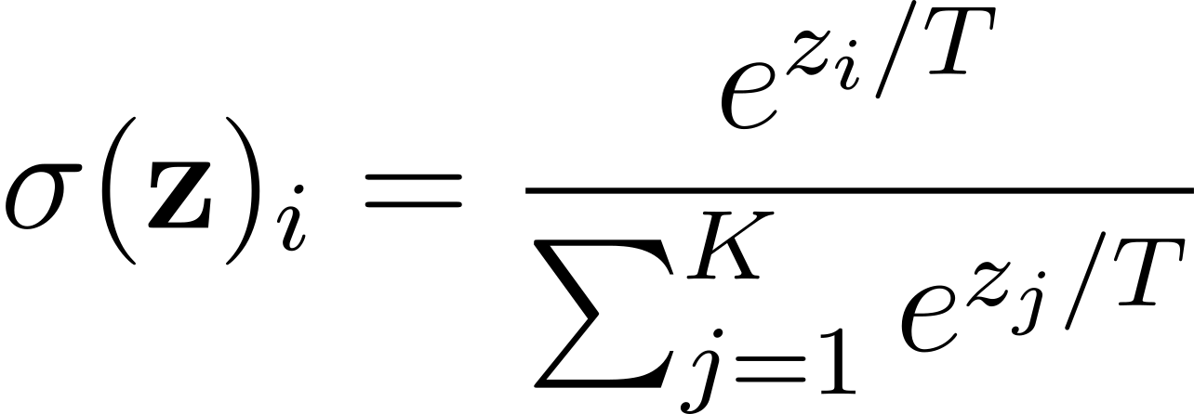
Softmax
Here is an equation:

Slide 12
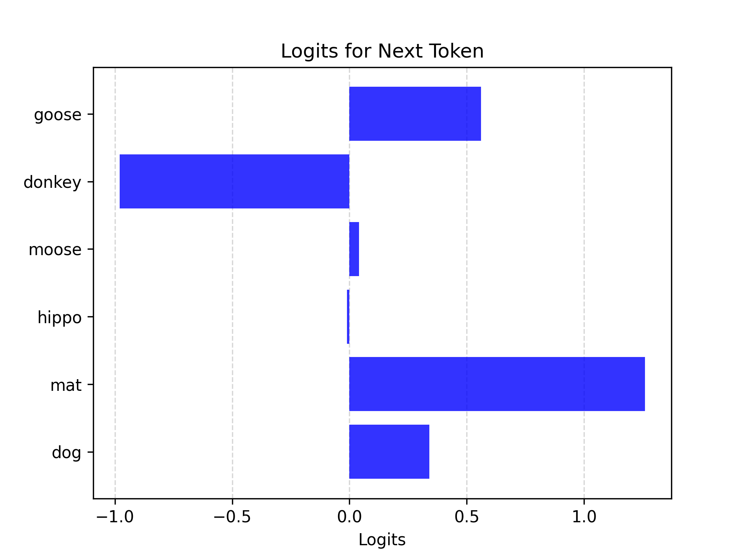
Softmax
"the cat sat on the _____"
goose | 0.34
donkey | 1.26
moose | -0.01
hippo | 0.04
mat | -0.98
dog | 0.56

Slide 13
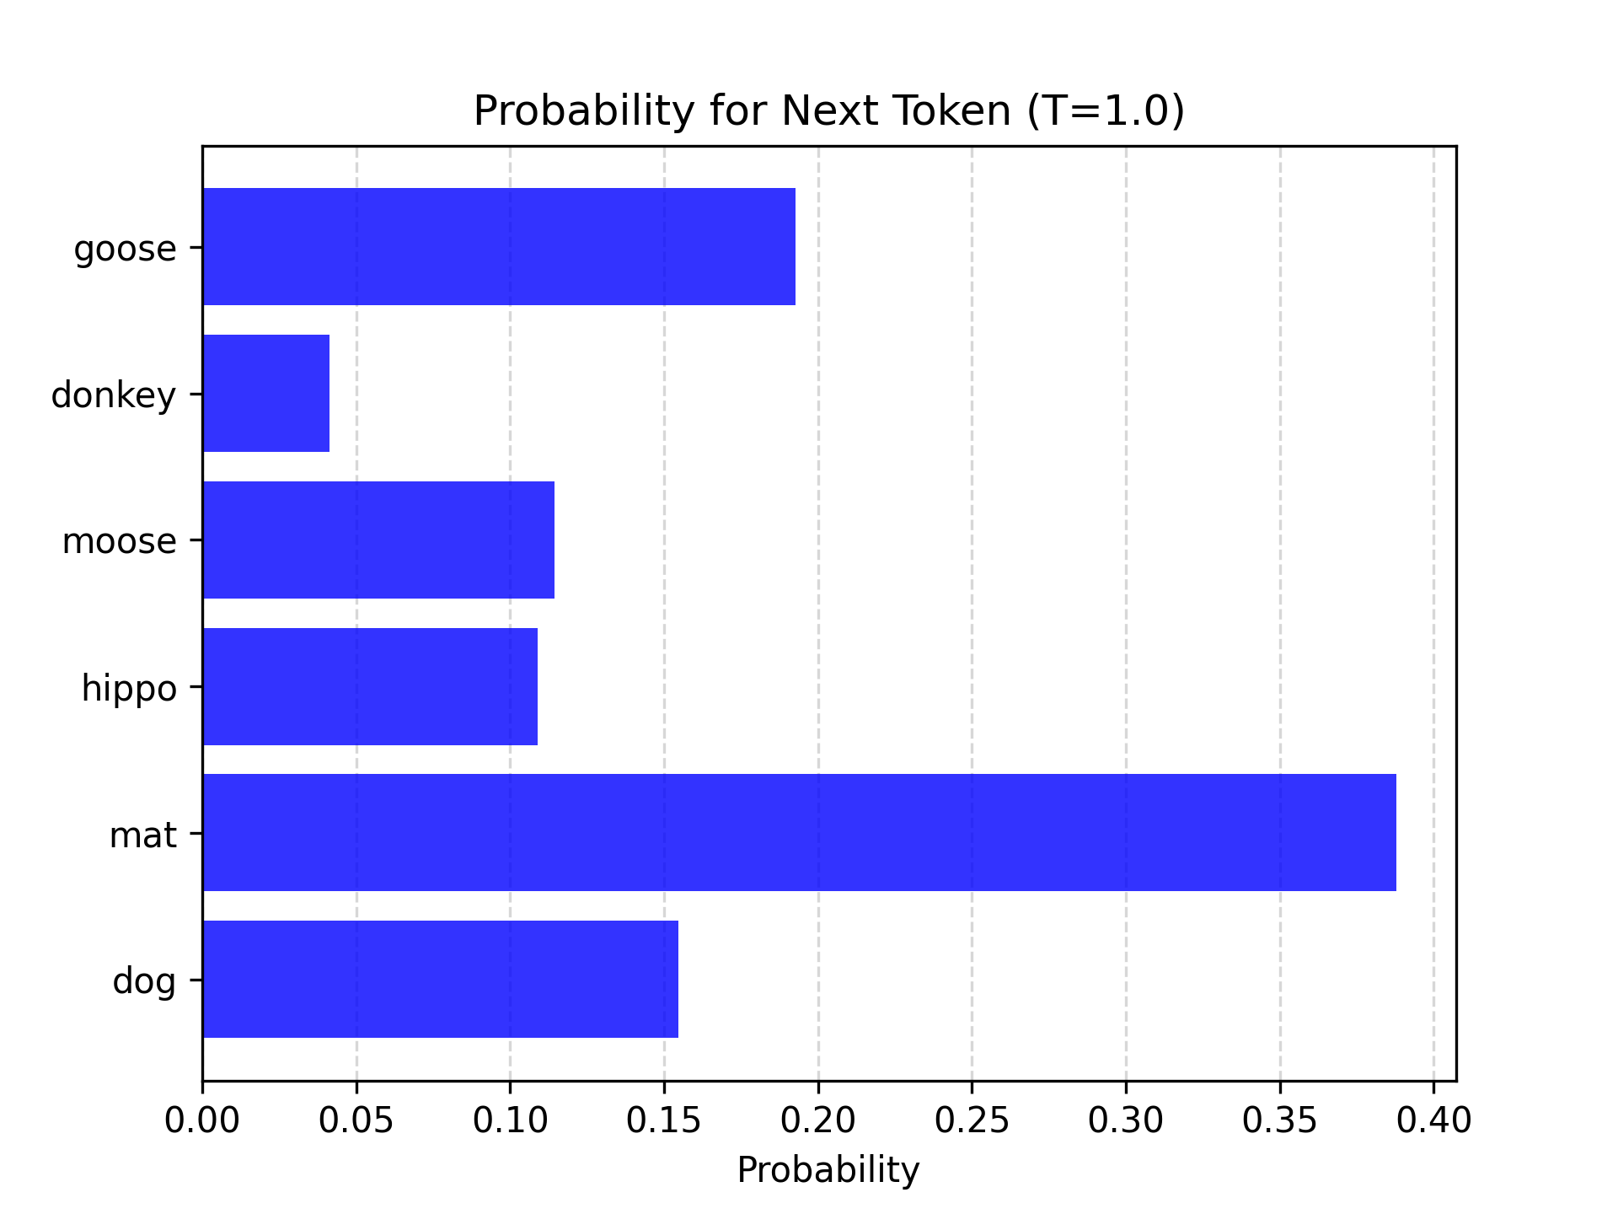
Softmax
"the cat sat on the _____"

Slide 14
Softmax
What does T do?
temperature

Slide 15
Softmax
T = 1.0
"the cat sat on the _____"

Slide 16
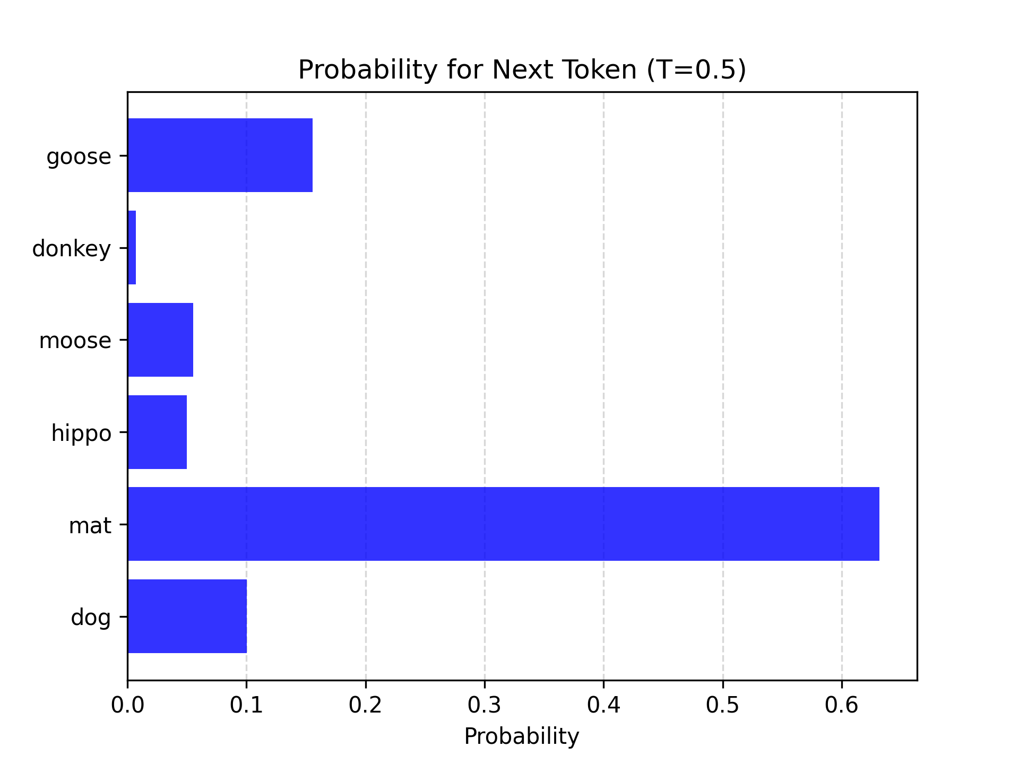
Softmax
T = 0.5
"the cat sat on the _____"

Slide 17
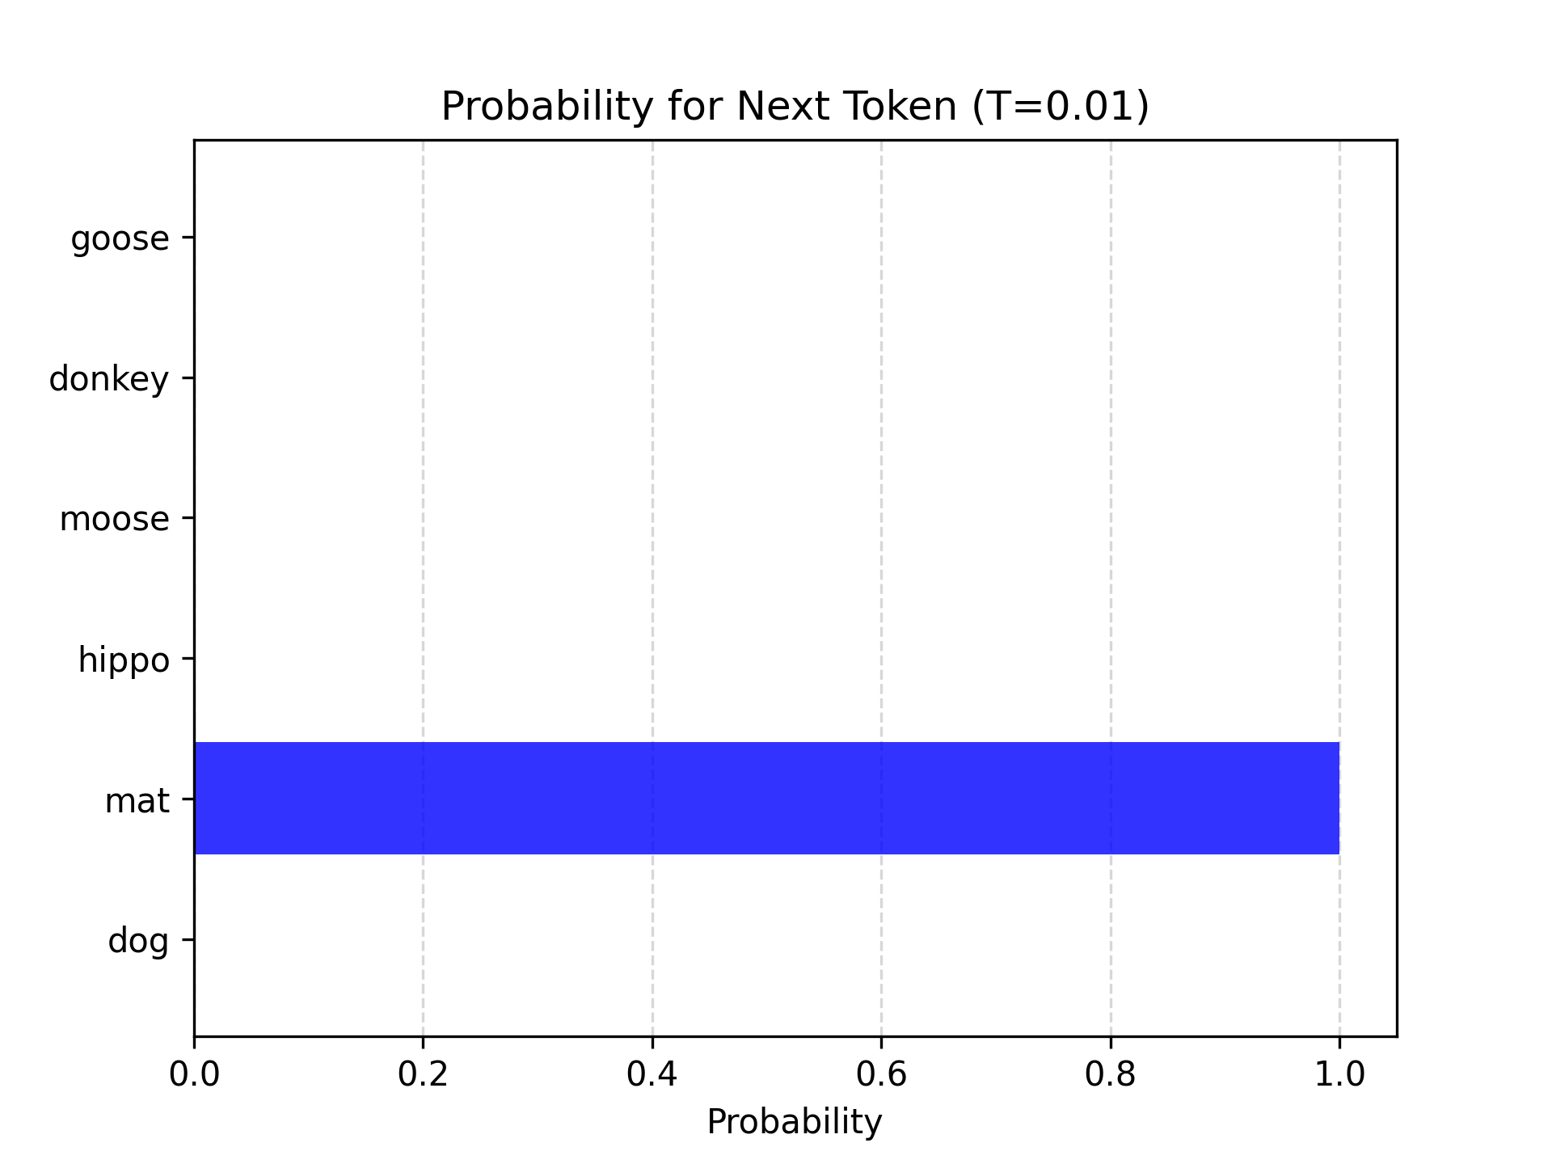
Softmax
T = 0.01
"the cat sat on the _____"

Slide 18
Softmax
T = 1.0
"the cat sat on the _____"

Slide 19
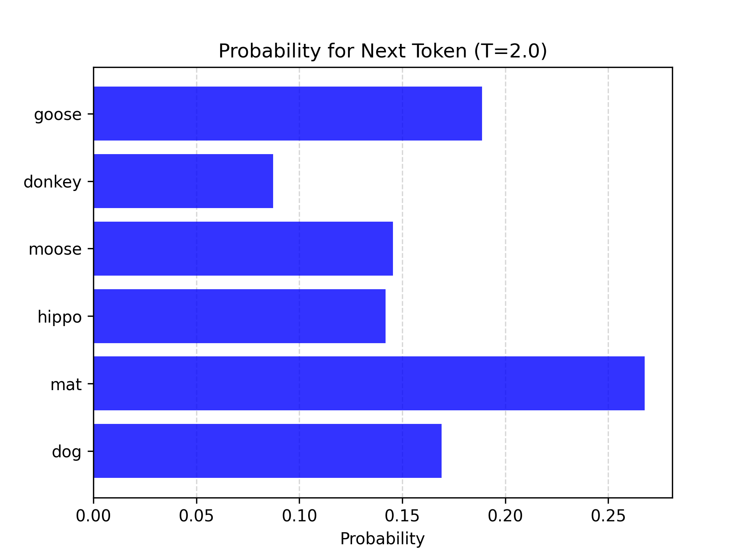
Softmax
T = 2.0
"the cat sat on the _____"

Slide 20
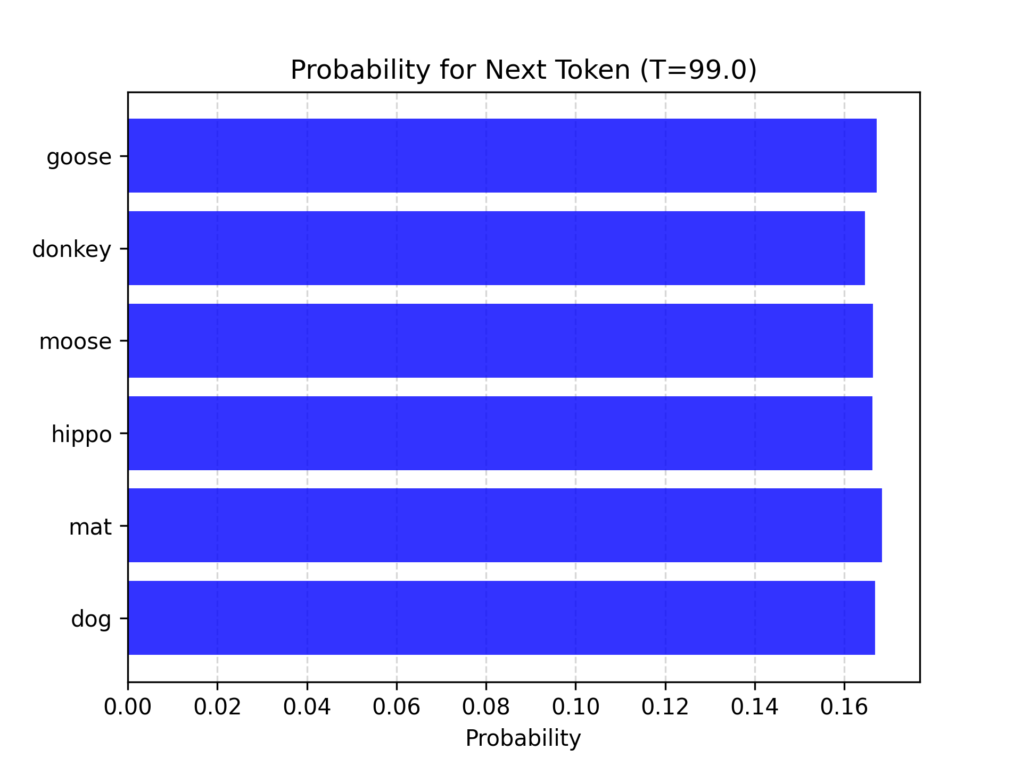
Softmax
T = 99.0
"the cat sat on the _____"

Slide 21

Softmax
Softmax converts raw logits to a probability distribution
Changing the temperature parameter alters the entropy of the distribution

Slide 22
Sampling
Greedy sampling Pick the top score
Top-p The cumulative probability cutoff for token selection. Lower values mean sampling from a smaller, more top-weighted nucleus.
Top-k Sample from the k most likely next tokens at each step. Lower k focuses on higher probability tokens.
In OpenAI models, setting T = 0 essentially does greedy sampling, and top-k is not exposed

Slide 23
But wait...
We said we needed an object of size:
[sequence_length, vocab_size]
But all we've done is describe a Softmax function.

Slide 24
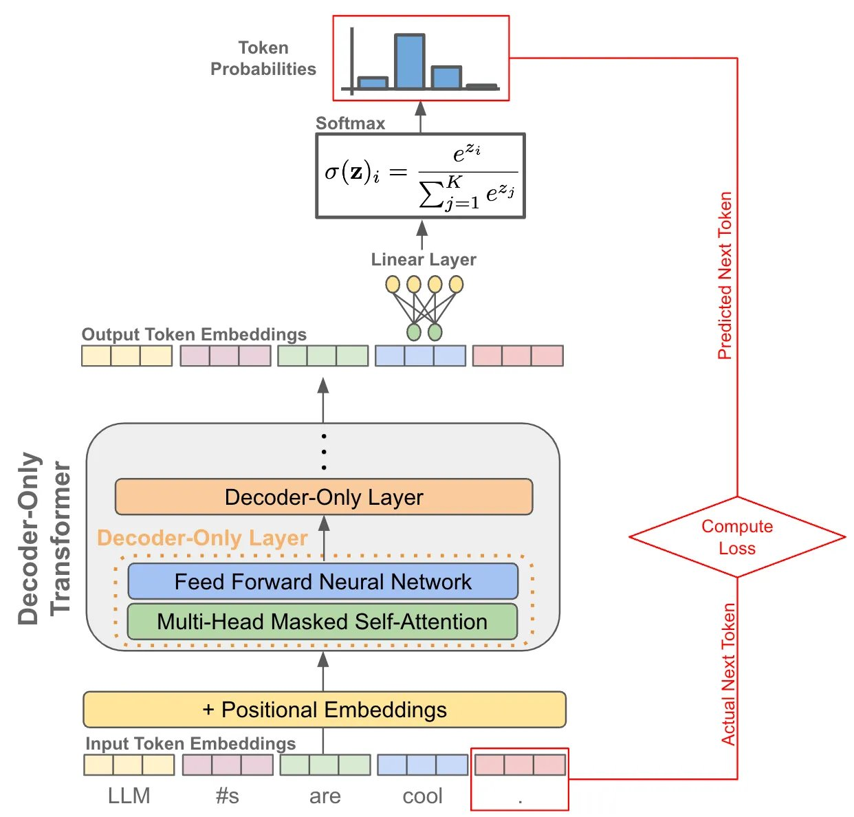
Just use a linear layer

Slide 25
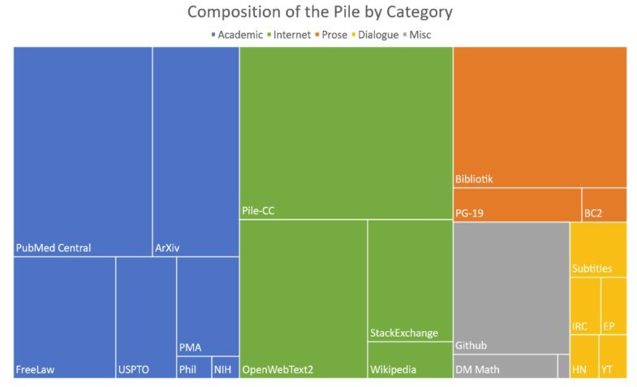
Training data
~200k books
~27B Tokens
~110GB
< 0.2%!!
Llama 3
~15T tokens
~44TB

Slide 26
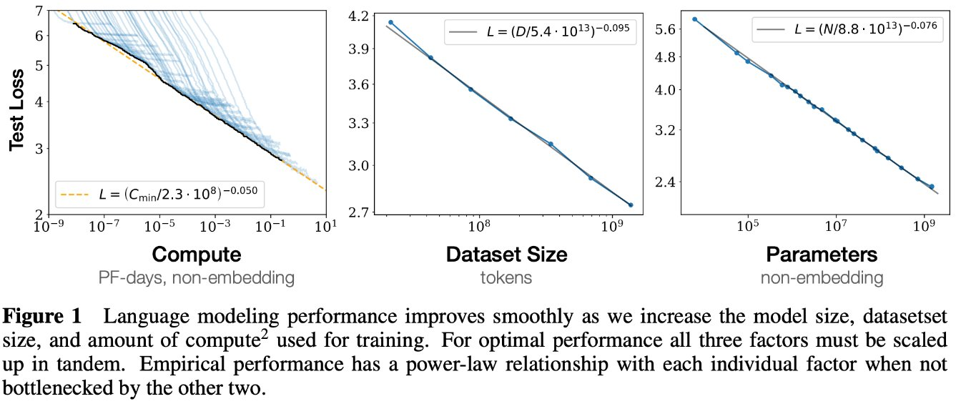
Scaling laws

Slide 27
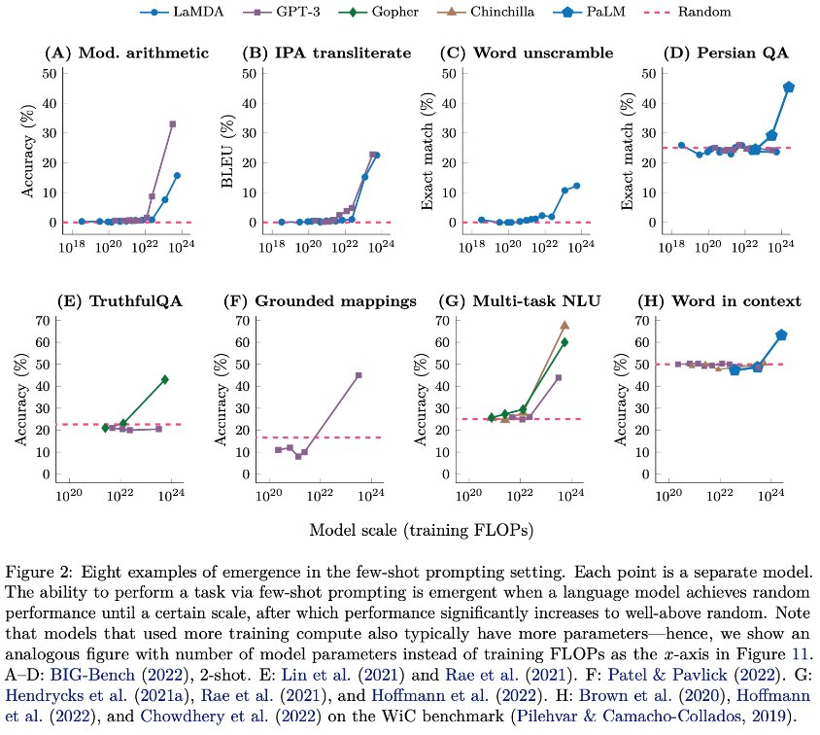
Emergence

